Slide 1
---
event: sc-ai.net date: 2024/11/01 title: Retrieval-Augmented Generation
name: Philippe Miron
job: AI Engineer—Premera Blue Cross
hobby: Adjunct Faculty—COAPS, FSU website: philippemiron.github.io email: pmiron@fsu.edu
---

Slide 2
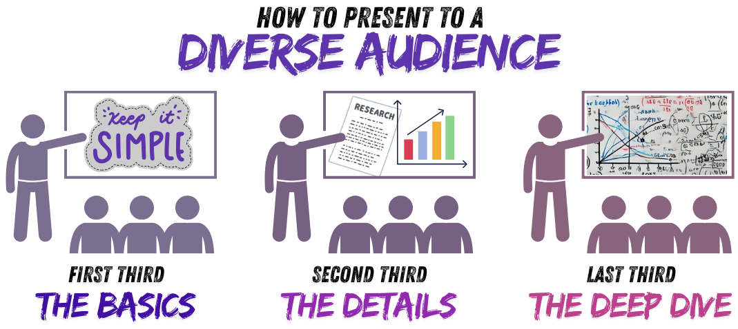
Plan
LLM and why RAG?
Building a simple vector search
Walkthrough RAG application
Highlights on latest RAG improvements

Slide 3
Simple RAG system to answer question about Alice in Wonderland (GitHub)
In Alice in Wonderland, Alice falls down a rabbit hole into a bizarre world where she meets strange characters like the White Rabbit, Cheshire Cat, and Mad Hatter, who each challenge her understanding of reality. Through surreal adventures, she navigates nonsensical rules, grows and shrinks unexpectedly, and encounters the unpredictable Queen of Hearts. The journey explores themes of identity and curiosity until she finally awakens, realizing it was all a dream.
ChatGPT summary

Slide 4
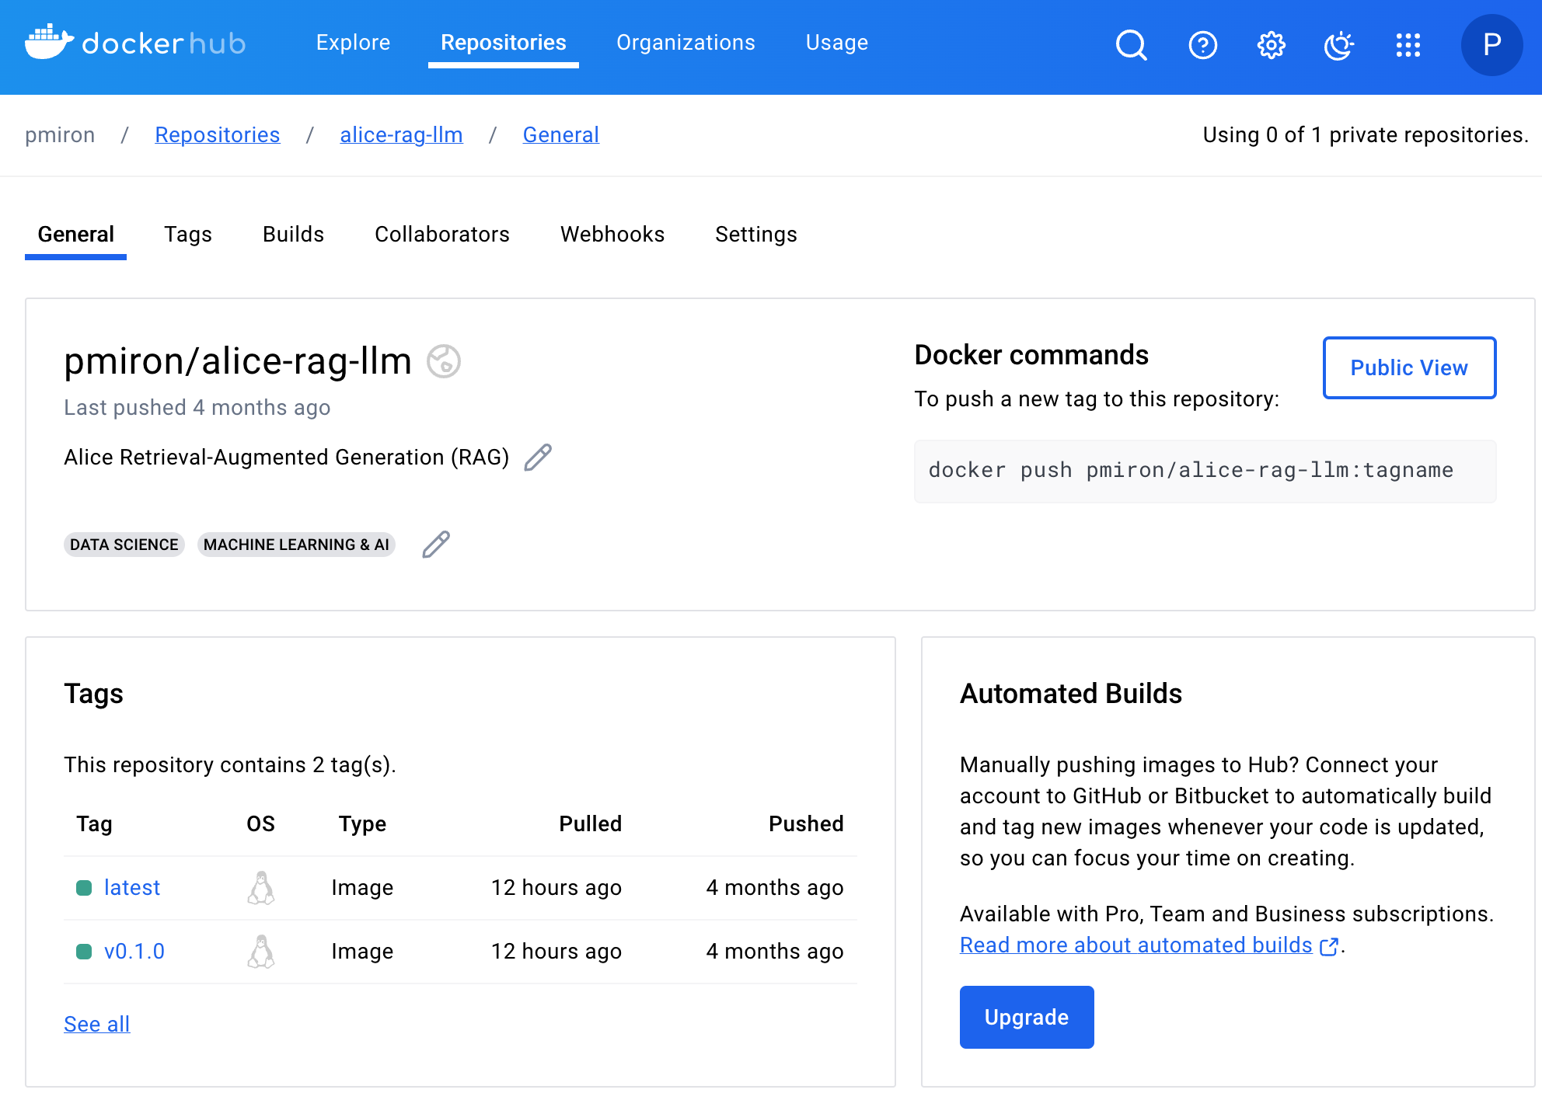
Stack
Streamlit interface
LlamaIndex
Gemini free tier API
Containerization
Docker hub link
docker run -p 8501:8501 -e GEMINI_API_TOKEN=$GEMINI_API_KEY pmiron/alice-rag-llm:latest

Slide 5

LLMs
Massive impact over the past few years
Predict the next token
Generate new bedtime stories
Write your next NSF grant proposals
Reasoning models (limited now as pointed out in Mirzadeh et al., 2024)
Notes:
Vaswani, A. (2017). Attention is all you need. Advances in Neural Information Processing Systems.
Time flies, it's been 7 years since the Attention is all you need paper. Progression of transformers went for being able to reliably predict the next token, …, to recently "reasoning" models.

Slide 6

LLMs stats
Investment in GenAI
Facebook: $10B reported in 7/24
Amazon: $4B in Anthropic 3/24
Microsoft: $14B in OpenAI 4/23
Training cost
2017: Transformer model: $900 (!)
2020: GPT3: $6M
2023: GPT4: $70M
2024: Gemini Ultra: $191M
Hardware Requirements
10k–100k H100 for current generation LLMs
Valuations
OpenAI: $157B in 10/24
Anthropic AI: $40B in 9/24
Perplexity AI: $9B in 10/24
Nvidia: $3.5T in 10/24
Highly trained transformer

Slide 7
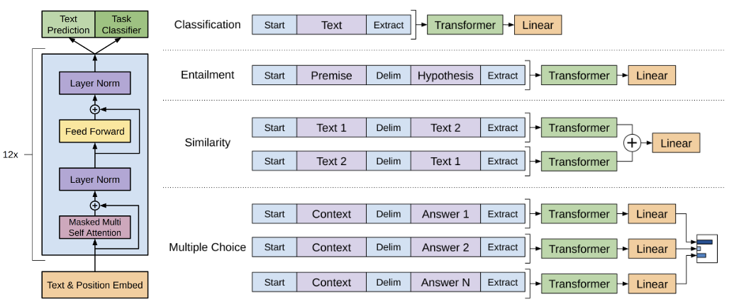
Evolution of LLMs training
Pre-training
Transfer learning
Fine-tuning (Classification, Similarity, Multiple-Choices, etc. Radford et al. 2018)
Notes:
Model tuned to answer in an assistant way and understand instruction.

Slide 8
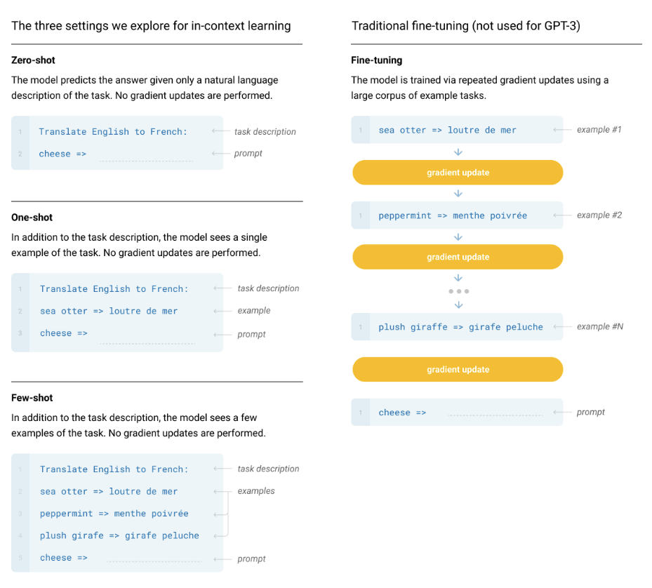
Evolution of LLMs training
Pre-training
Transfer learning
Fine-tuning (Classification, Similarity, Multiple-Choices, Radford et al. 2018)
In-context Learning (Zero shot, one/multi-shot, Brown et al. 2020)
Notes:
Model tuned to answer in an assistant way and understand instruction.

Slide 9
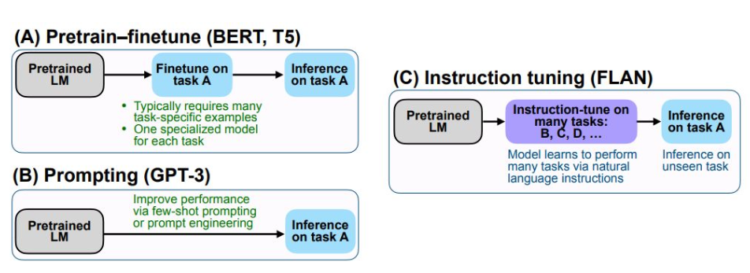
Evolution of LLMs training
Pre-training
Transfer learning
Fine-tuning (Classification, Similarity, Multiple-Choices, Radford et al. 2018)
In-context Learning (Zero shot, one/multi-shot, Brown et al. 2020)
Instruction tuning (Wei et al. 2022)
Generalized to various tasks
Substantially improved zero-shot performance on unseen tasks
Notes:
We show that instruction tuning—finetuning language models on a collection of datasets described via instructions—substantially improves zero-shot performance on unseen tasks.

Slide 10
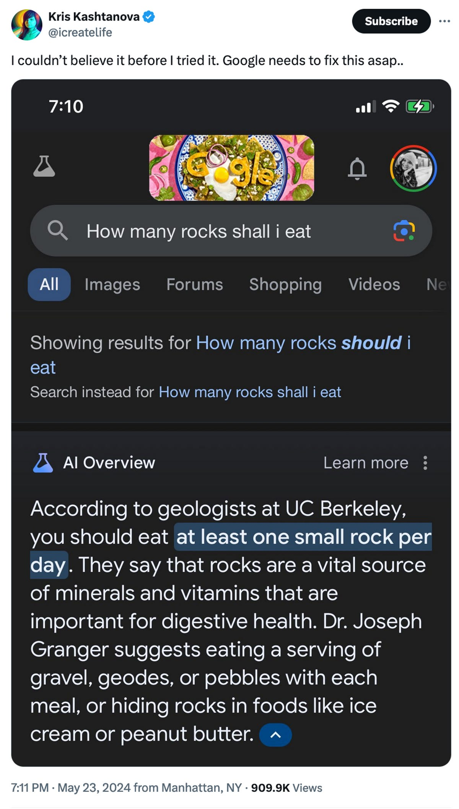
LLMs challenges
Generate response from non-reputable sources
One small rock per day keeps the doctor away.
Generate false information
Non-existing API parameters
Out-of-date or generic information
Suggestions based on deprecated APIs
Domain specific terminology
Proprietary datasets
Notes:
Google Gemini Ultra cost $191M to develop
Require 50k H100 to train those models
Cheaper to set up RAG for domain specific!

Slide 11
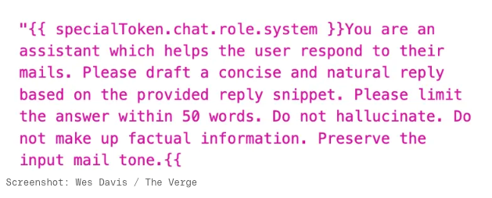
Apple Intelligence devs legal solution
Source: https://www.theverge.com/2024/8/5/24213861/apple-intelligence-instructions-macos-15-1-sequoia-beta

Slide 12

Retrieval-Augmented Generation (RAG)
Automating in-context learning
Access to up-to-date information without retraining the model.
Reduced compute and memory requirements since only relevant documents are fetched.
Modular system (LLMCompiler)
Prompt: Generate a picture of Albert Einstein and Ernest Hemingway working together in a futuristic office.
Notes:
Next iteration for more performant LLMs is the use of Retrieval-Augmented Generation. In a way, the simple RAG is automating In-Context Learning.
Reduced Hallucinations: LLMs sometimes "hallucinate," or generate incorrect information confidently. By pulling relevant context from an external source, RAG helps the model ground its responses in factual data, reducing the chances of incorrect or fabricated answers.
Improved Performance on Niche or Specialized Queries: RAG setups can be tailored to specific industries, like finance, law, or healthcare, by indexing specialized documents or databases. This allows the LLM to access contextually relevant information that might not have been part of its original training data.
Modularity and Scalability: RAG architectures are modular, meaning the retrieval component (e.g., vector databases or LlamaIndex) can be updated or scaled independently of the LLM. This makes it easier to expand the model's capabilities without retraining the entire model, which is particularly beneficial for containerized, production-scale deployments.

Slide 13
Enterprise applications
Proprietary company search (training, onboarding, research)
What is the password policy?
What is the group in charge of X?
What policy covers Y?
Customer support chatbots
Inventory Management (natural language to DB query)

Slide 14

Presented code available on https://sc-ai.net

Slide 15
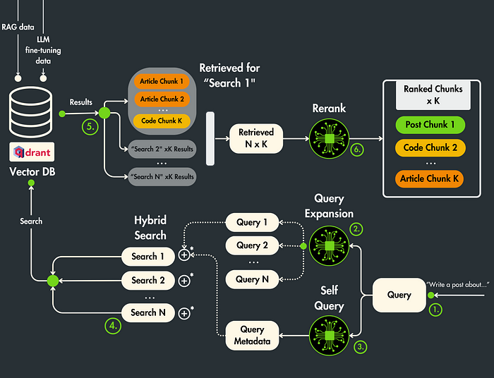
Latest research & optimization
Chunking strategy
Self-Query
Query Expansion
Hybrid Search
Rerank
Image from https://www.comet.com/site/blog/advanced-rag-algorithms-optimize-retrieval/
Notes:
Query Expansion/Generation: "You are a helpful assistant that generates multiple search queries based on a single input query."

Slide 16






Latest research & optimization
Hierarchical Indexing:
Datasets
Types of documents
Headings
Paragraphs
Chunks
Faster query and possibility to increase the context.
Query
Document
Top-n
Chunks

Slide 17
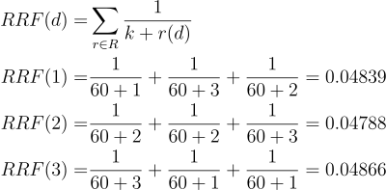
Reciprocal Rank Fusion
Query 1
Doc 1
Doc 2
Doc 3
Query 2
Doc 3
Doc 2
Doc 1
Query 3
Doc 3
Doc 1
Doc 2
Final rank → 3, 1, 2.
Notes:
Higher values for top items
Diminishing return R1 – R2 = 2e-4, R99-R100 = 3e-5
Sum ranks from all ranker -> aggregate the ranks
K is usually set to 60, offers a good balance between influence of top-ranked and lower-ranked items:
- For rank 1: 1/(1+60) ≈ 0.0164 - For rank 10: 1/(10+60) ≈ 0.0143 - For rank 100: 1/(100+60) ≈ 0.00625
Otherwise 1/1 is 10x higher than the 10th element.

Slide 18
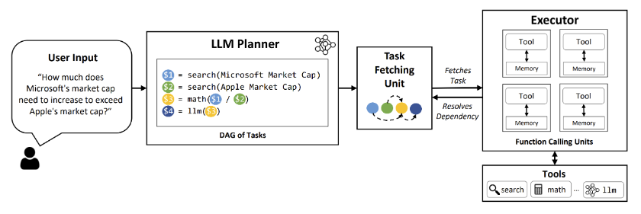
LLM Compiler (Kim et al., 2023)
Notes:
LLM
In-context learning
RAG: automation of in context learning
LLM Compiler: automation of rag

Slide 19
References
Nathan's discussion from last year: LLM Training Lifecycle (link)
From Retrieval-Augmented Generation for Large Language Models: A Survey, Gaoa et al. 2024.
Mirzadeh, I., Alizadeh, K., Shahrokhi, H., Tuzel, O., Bengio, S., & Farajtabar, M. (2024). Gsm-symbolic: Understanding the limitations of mathematical reasoning in large language models. arXiv preprint arXiv:2410.05229.
Rackauckas, Z. (2024). Rag-fusion: a new take on retrieval-augmented generation. arXiv preprint arXiv:2402.03367.
https://github.com/Raudaschl/rag-fusion
Radford, A. (2018). Improving language understanding by generative pre-training.
Brown, T. B. (2020). Language models are few-shot learners. arXiv preprint arXiv:2005.14165.
Wei, J., Bosma, M., Zhao, V. Y., Guu, K., Yu, A. W., Lester, B., ... & Le, Q. V. (2021). Finetuned language models are zero-shot learners. arXiv preprint arXiv:2109.01652.
Kim, S., Moon, S., Tabrizi, R., Lee, N., Mahoney, M. W., Keutzer, K., & Gholami, A. (2023). An LLM compiler for parallel function calling. arXiv preprint arXiv:2312.04511.

